Slide 1
Introduction to Board Management
FUNDRAISING FUNDAMENTALS SERIES
JANUARY 2023

Slide 2
Before We Begin
You may want a pen and paper to take notes during this presentation.
Feel free to pause the presentation here to grab supplies!
You will be able to download a copy of this presentation.
If you have any questions, email info@ccsfundraising.com.

Slide 3
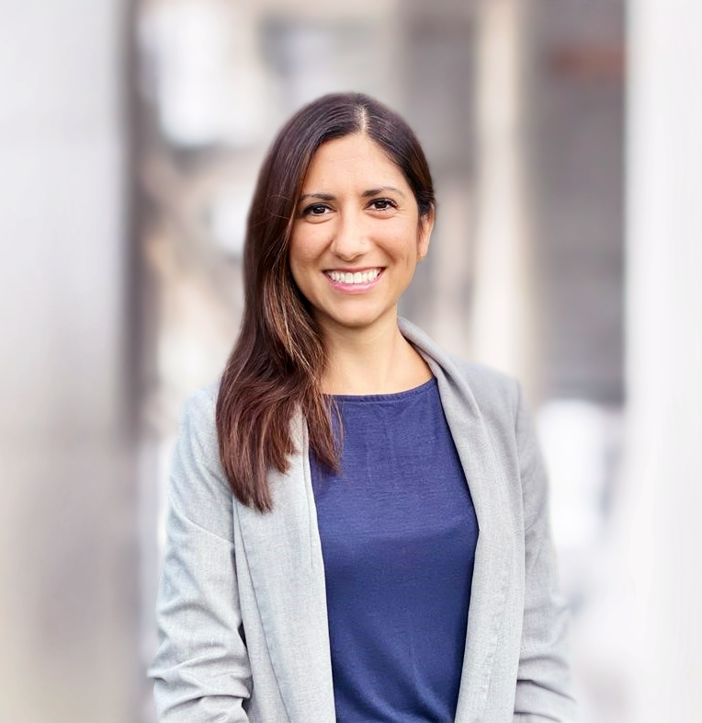
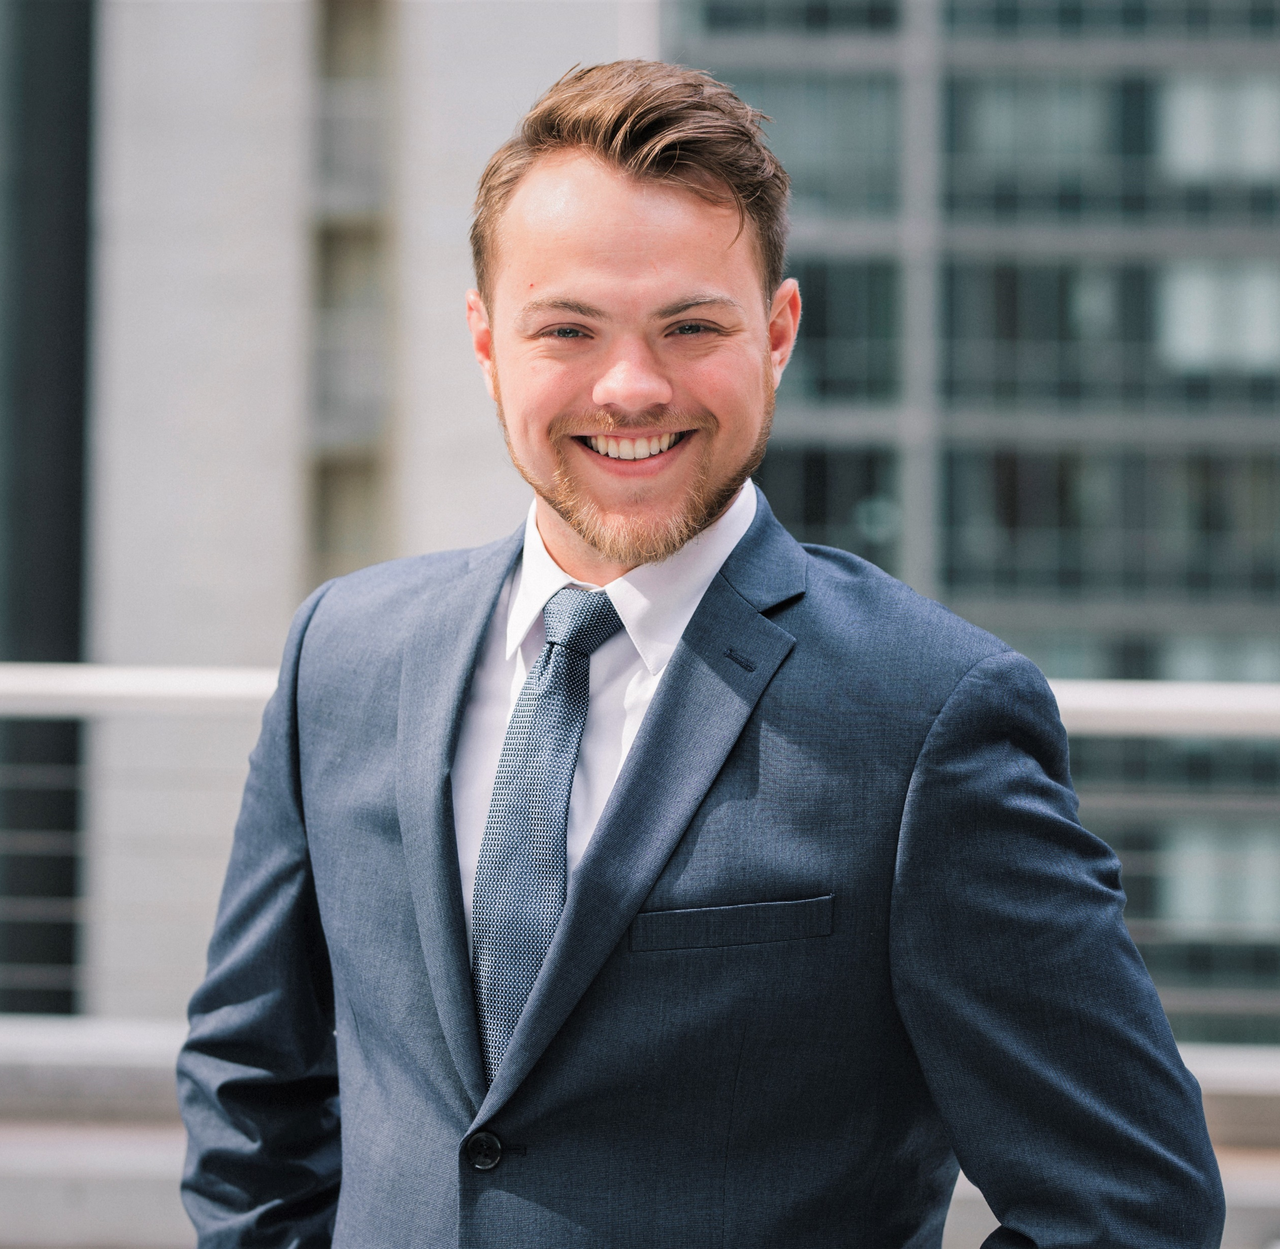
TODAY’S Presenters
Ashley Meruani
Alexander Fruin
Vice President
CCS Fundraising
Senior Director
CCS Fundraising

Slide 4
ABOUT CCS FUNDRAISING
Celebrating 75 years of transformational partnerships with nonprofits.
Leading experts in campaign and development strategy for 75 years
Experienced across nonprofit sectors and locations
Full-time professional staff plans, implements, and manages fundraising projects

Slide 5
FUNDRAISING FUNDAMENTALS
Fundraising Fundamentals is an effort launched in 2020 by a volunteer group of CCS directors.
While open to all nonprofits, our hope for this library is that it will provide meaningful fundraising resources and step-by-step guidance to emerging nonprofits that partner with communities of color, are led by leaders of color, or both. This is part of our firm’s commitment to anti-racism and social justice.
To learn more, visit the Fundraising Fundamentals page at www.ccsfundraising.com.

Slide 6
Defining a Board of Directors
Notes:
A pop of color is great for dividing up sections of your presentation.

Slide 7
What is a Board of Directors?
A board is a formal collection of individuals who serve as the highest leadership body of an organization. For a nonprofit organization, the board performs the following governing duties:
Evaluate the performance of the chief executive and senior administrative staff
Participate in the selection process for a new chief executive, as necessary
Ensure strong fiduciary oversight and financial management
Engage in fundraising/resource development activities
Engage in strategic and organizational planning, often in partnership with executive staff
Approve of and monitor the organization’s programs and services
Enhance the public image of the organization through regular, vocal, and visible advocacy in the community

Slide 8
Five Core Responsibility Areas
1
Mission & Vision
Know the organization’s mission, policies, programs, and needs.
2
Finance
Read and understand the organization’s financial statements and activities in order to maintain financial solvency.
3
Fundraising
Support the organization with a financial contribution each year.
4
Engagement
Attend and participate in board meetings and events related to the orgnaization.
5
Community
Serve as visible advocates and ambassadors for the organization within the community.

Slide 9
Board Governance: Models & Meetings

Slide 10
3 Governance Models
Governance Model | Focus | Member Composition | Overview
WORKING BOARD | Day to day operations of a non-profit | Close connections to nonprofit executive staff Members are invited to sit on the board | Members may serve as ad-hoc or volunteer staff members. This model is common in newer nonprofits who may be in their first few years of existence. The board may have committees comprised of outside community members and Board Members.
FUNDRAISING BOARD | To raise philanthropic funds from individuals, foundations, and corporations | Strong financial capacity, deep community connections, or both Members are often appointed or invited to sit on the board. | Members may advise on strategic matters, but they stay out of organizational management duties. This structure is common in more mature organizations.
TRADITIONAL BOARD | To balance organizational strategy with stakeholder engagement | Specific expertise, financial capacity, and/or community connections Members are often appointed or invited to sit on the board. | Members participate in committees for various governance roles, which provide opportunities for outside counsel. Members also assist with vetting of potential new members. This structure is common in established organizations.

Slide 11
Three areas of focus for successful board meetings
Prepare
Structure
Follow-up
Agenda is formulated well ahead of time and is strategic and high-level
Important issues and discussion points are communicated ahead of time
Date, time and location is consistent, and reminders are sent early and often
Board Chair leads
Stay on task
Allow for questions and discussion
Sent in a timely manner and includes meeting minutes and action items
Outline key decisions and next steps
Offer a reminder of the next meeting date, time and location

Slide 12
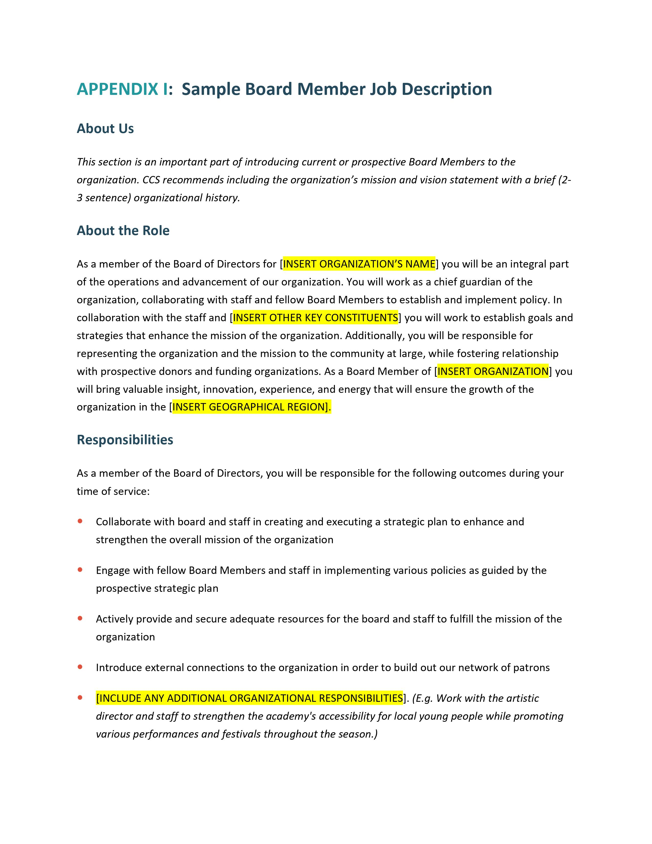
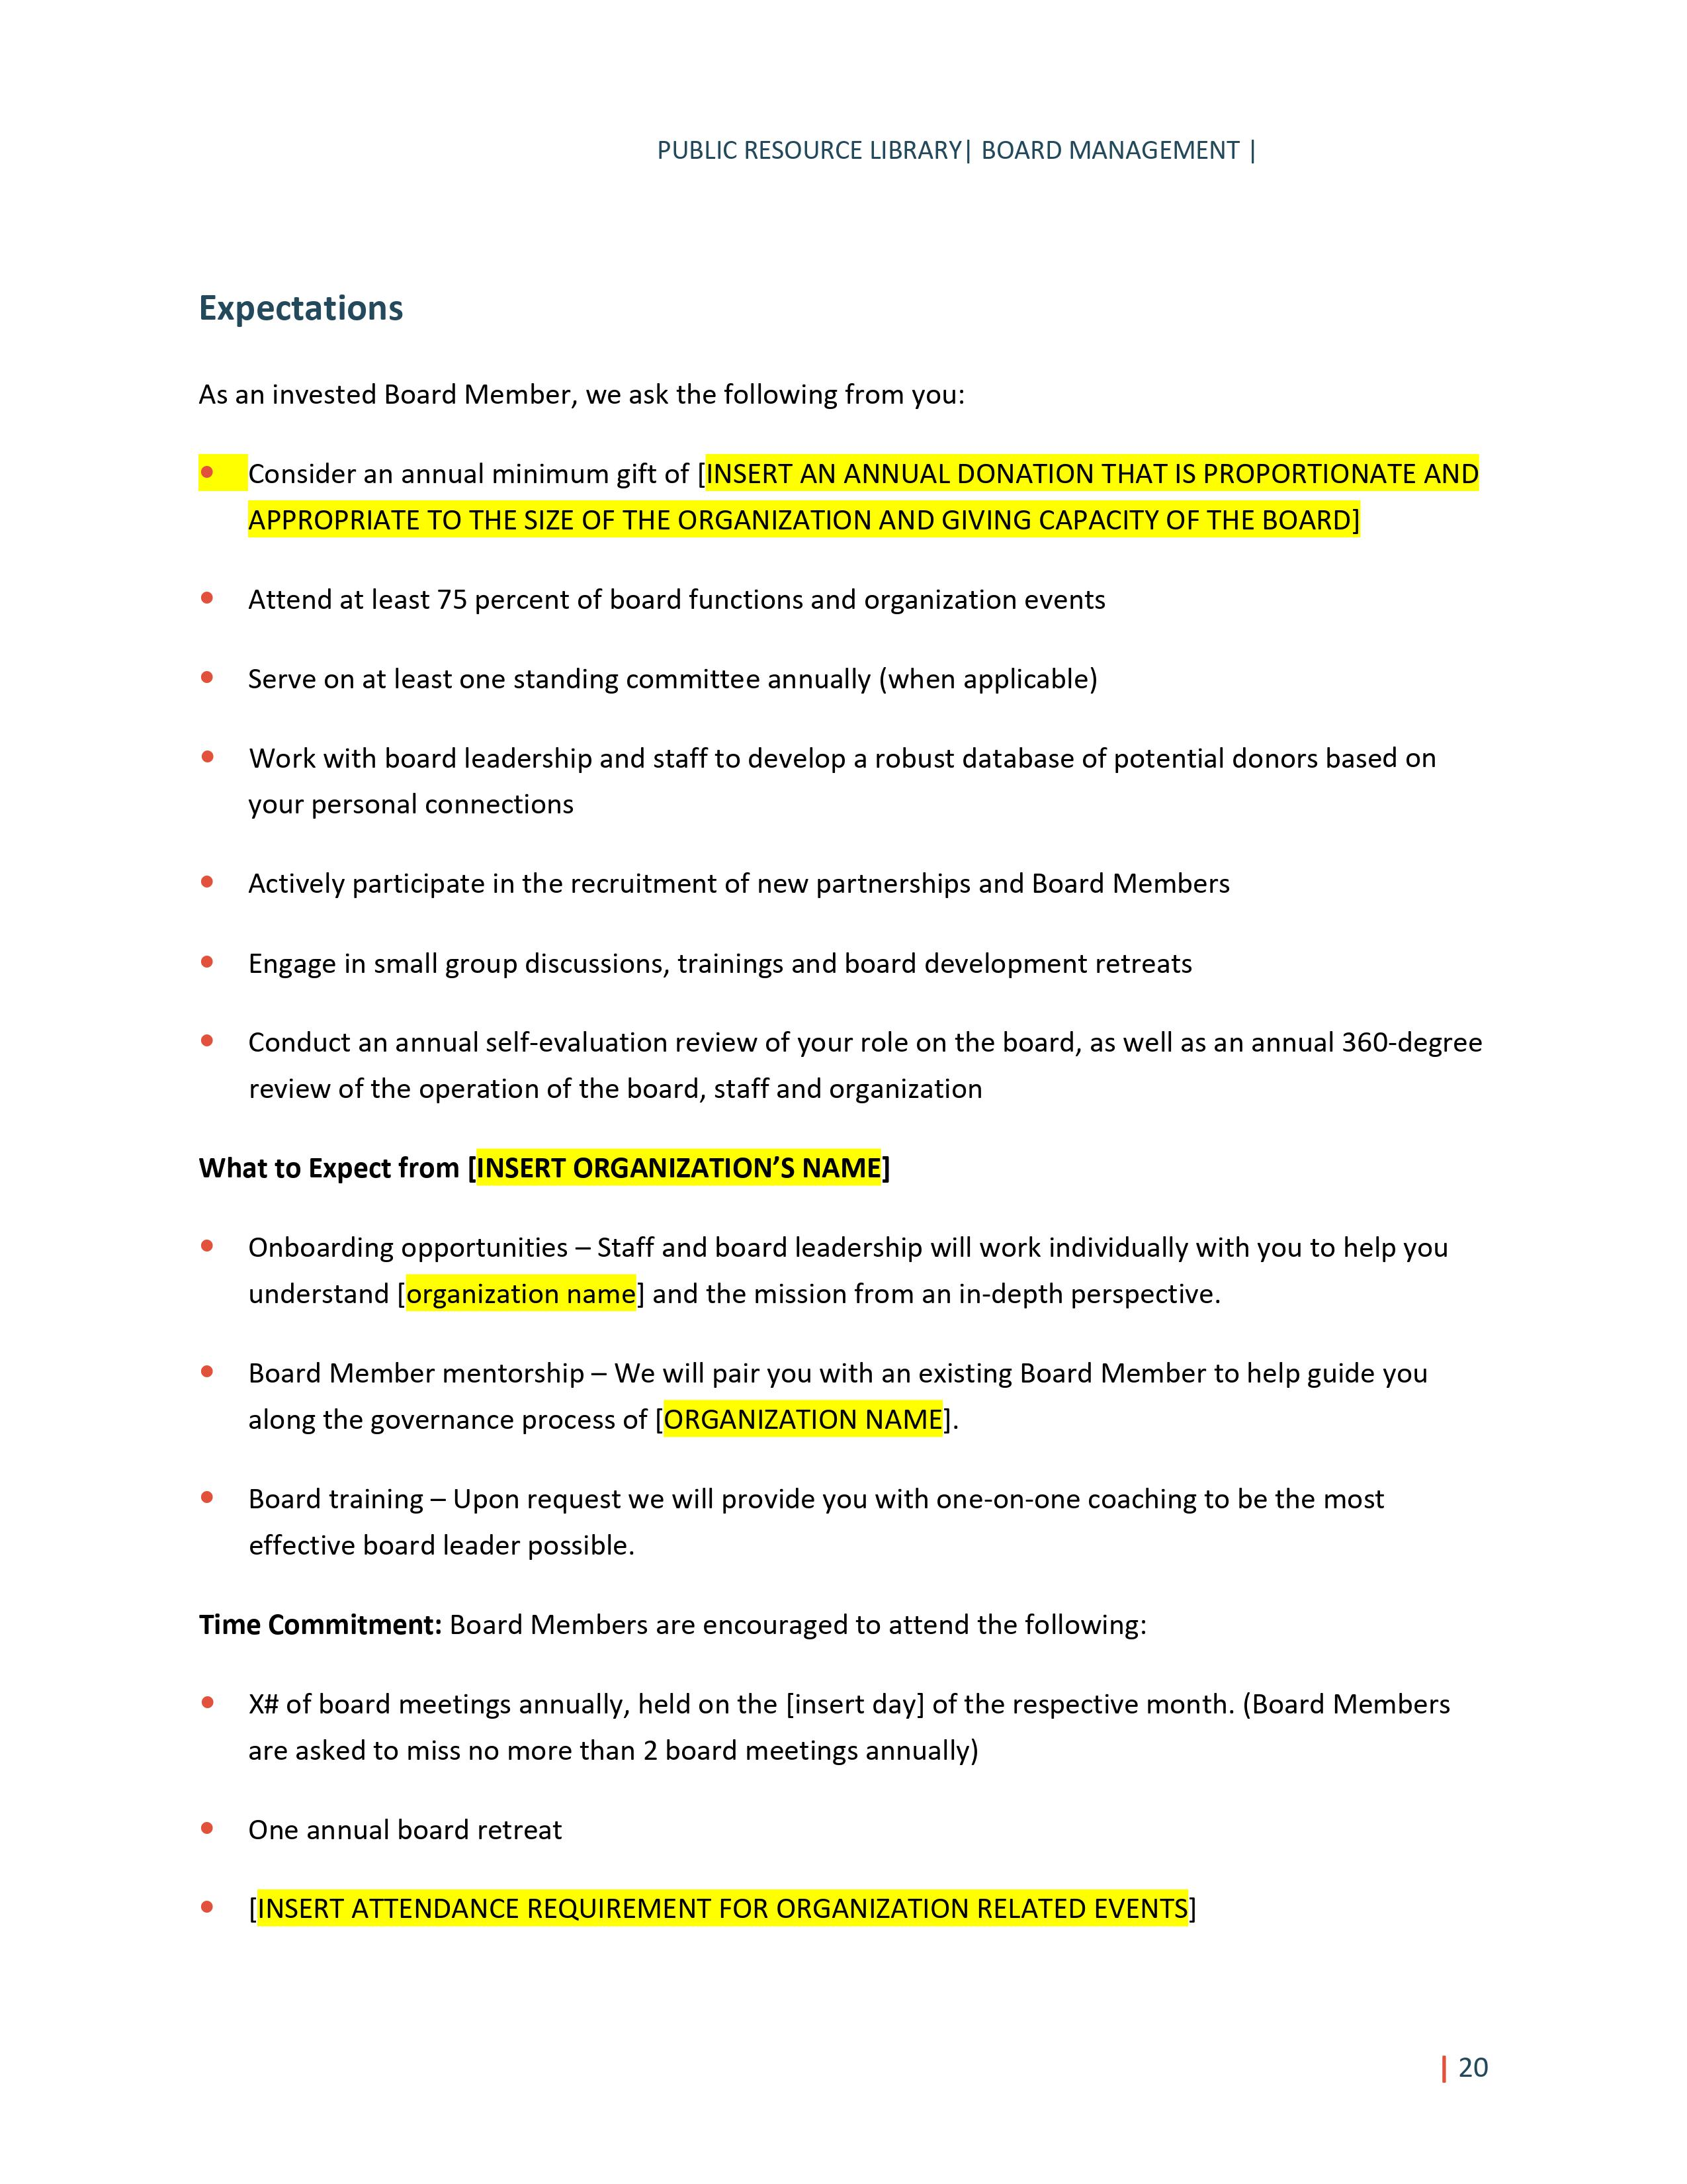
Communicating responsibilities

Slide 13
ADDITIONAL RESOURCES
Thank you for joining us for today’s video! You can access additional resources through the Fundraising Fundamentals series:
01
Review other topics via the Fundraising Fundamentals series.
Peruse the “CCS Insights” tab on our website.
Reach out to our team at info@ccsfundraising.com.
02
03

