Slide 1
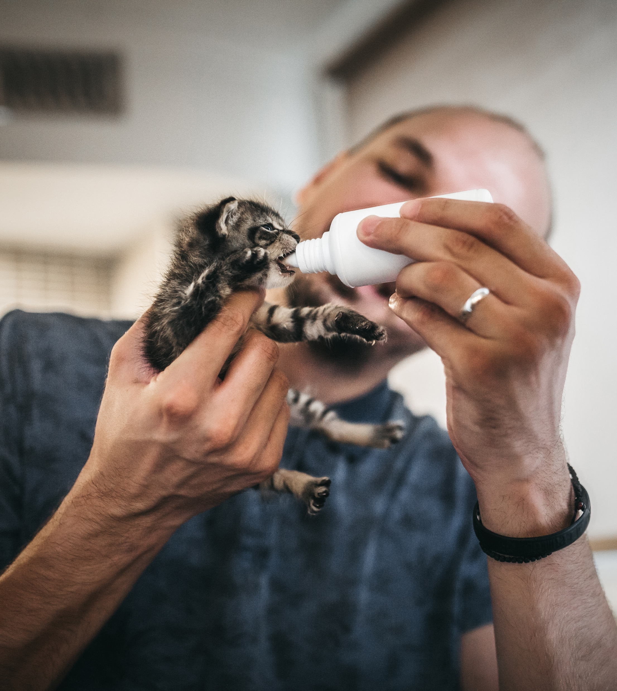


Introduction to
Moves Management
FUNDRAISING FUNDAMENTALS SERIES
JANUARY 2023
Notes:
*Use dark photo or add overlay to keep logo legible

Slide 2
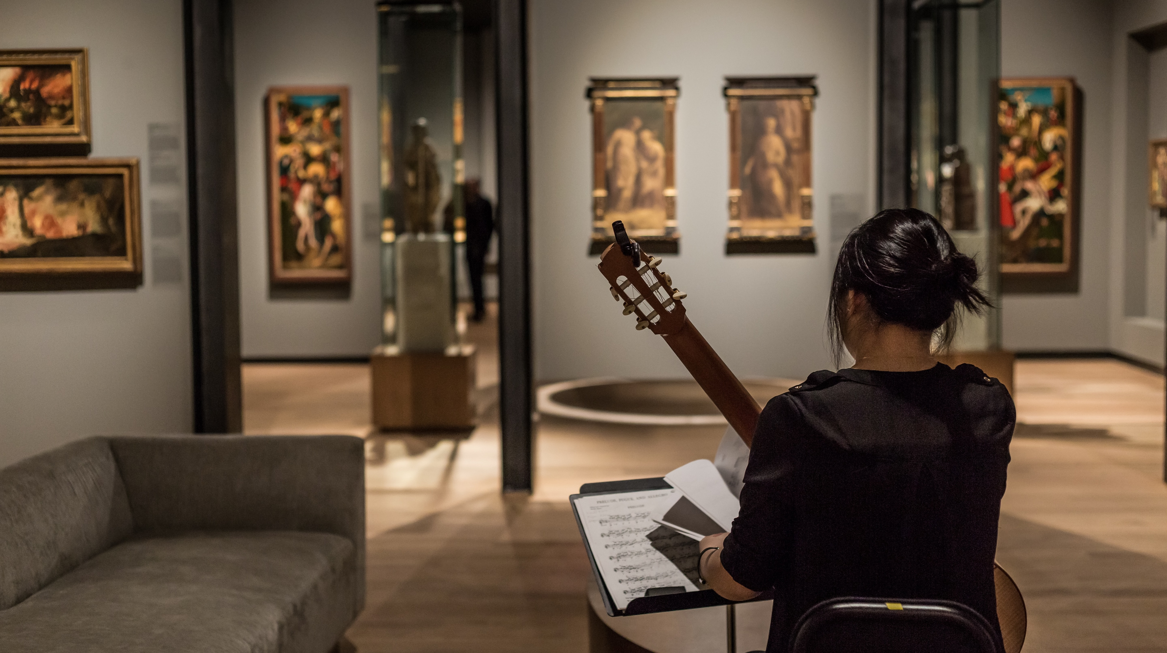
Before We Begin
You may want a pen and paper to take notes during this presentation.
Feel free to pause the presentation here to grab supplies!
You will be able to download a copy of this presentation.
If you have any questions, email info@ccsfundraising.com.

Slide 3
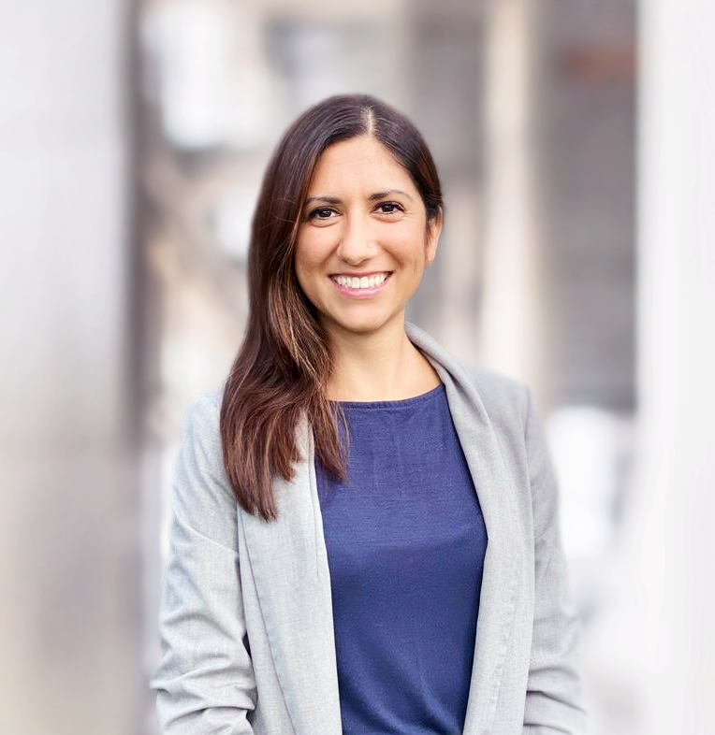
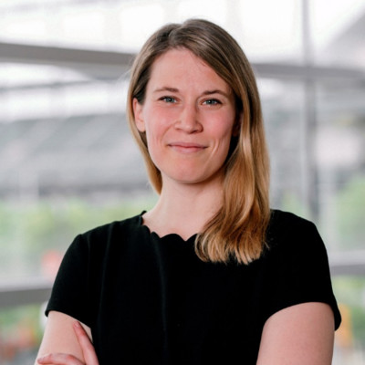
TODAY’S Presenters
Ashley Meruani
Lauren Ekmekjian
Vice President
CCS Fundraising
Vice President
CCS Fundraising

Slide 4



ABOUT CCS FUNDRAISING
Celebrating 75 years of transformational partnerships with nonprofits.
Leading experts in campaign and development strategy for 75 years
Experienced across nonprofit sectors and locations
Full-time professional staff plans, implements, and manages fundraising projects

Slide 5

FUNDRAISING FUNDAMENTALS
Fundraising Fundamentals is an effort launched in 2020 by a volunteer group of CCS directors.
While open to all nonprofits, our hope for this library is that it will provide meaningful fundraising resources and step-by-step guidance to emerging nonprofits that partner with communities of color, are led by leaders of color, or both. This is part of our firm’s commitment to anti-racism and social justice.
To learn more, visit the Fundraising Fundamentals page at www.ccsfundraising.com.

Slide 6

Moves Management Overview
Notes:
A pop of color is great for dividing up sections of your presentation.

Slide 7
WHAT IS MOvES MANAGEMENT?
Moves management is the process by which one or more representatives of an organization lead a donor or potential donor through a strategic engagement process toward giving to your organization.
Each “move” is a step toward furthering the relationship
Moves management enables fundraisers to engage each prospective donor
The most successful requests for support are built from a strong relationship between your organization and the donor

Slide 8
THE DONOR CYCLE
A moves management system is a strategic relationship process.
Pastor Nate or a key volunteer meets one-on-one with a prospective donor to ask for a gift
IDENTIFY
QUALIFY
CULTIVATE
BRIEF
SOLICIT
STEWARD
A potential connection
Gauge interest
Strengthen the relationship
Share the campaign, ask to solicit
Ask for a pledge of support
Thank them
BROADER CHURCH OUTREACH

Slide 9

Donor Cycle in Practice
Stay organized and set clear timelines
Be flexible
Use an inclusive lens
Follow-up is key

Slide 10


DONOR RECOGNITION MATTERS
Each move in the donor cycle is personalized, including the “thank you.”
Timely gift acknowledgement
Personalized recognition
Affinity groups

Slide 11

Case Studies

Slide 12



CASE STUDY 1: GRATEFUL PATIENT
How might we engage Prospect A?
Background
Research
Opportunity
Prospect A was a successfully treated at Community Health Clinic. It’s been a few weeks since the end of her treatment and, since then, Prospect A sent cookies to the Clinic as a thank you to the team.
After her appointments, she was known to sit outside on a bench, stating “Nature helps me heal.”
Prospect A is a CEO and founder of a local widget company. Her family has lived in the neighborhood for three generations.
In recent years, her company has been featured in the local “fast growing companies” list. She has never made a gift to Community Health Clinic.
Community Health Clinic is gearing up for a small campaign to renovate the healing garden on their campus.
12
© CCS Fundraising

Slide 13
CASE STUDY 2: THE PANDEMIC DONOR
How might we engage Prospect B?
Background
Research
Opportunity
Prospect B is a longstanding donor to the Neighborhood Food Pantry (NFP). Prospect B has made a gift to the NFP each year for the last dozen years, always around the end of the year. No formal engagement plan has been put in place for her, but the NFP always sends a holiday card. When the pandemic hit, Prospect B made a gift outside of her normal giving timeframe, this time for double the size of her average gift.
Prospect B is a partner at a local law firm and went to college and law school in the area. She is single.
Her gift to the NFP during the pandemic was $1,000. Research uncovers that she regularly makes annual gifts to her alma mater for $5K-$10K.
NFP would like to make a concerted effort to qualify donors that gave during the pandemic and move them through the pipeline.
Capitalizing on the opportunity, NFP would like to run a mini-campaign to start an endowment that could help with operating costs.
13
© CCS Fundraising

Slide 14
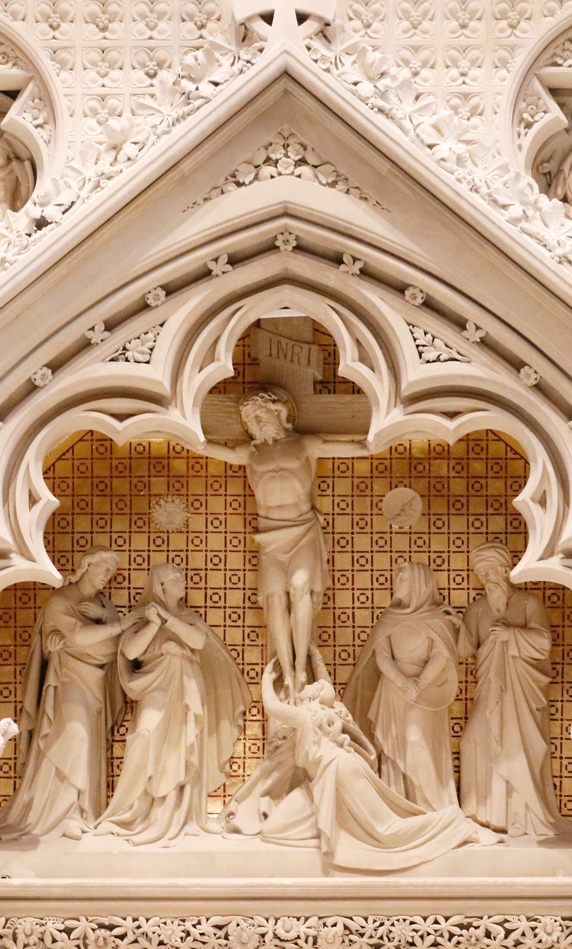
Wrapping up

Slide 15

KEY TAKEAWAYS
Moves management is a strategic engagement process
The donor cycle includes identification, qualification, cultivation, briefing, solicitation, and stewardship
Consider using an inclusive lens at each step
Donor stewardship and recognition is important to underscoring impact
When in doubt, say thank you!

Slide 16
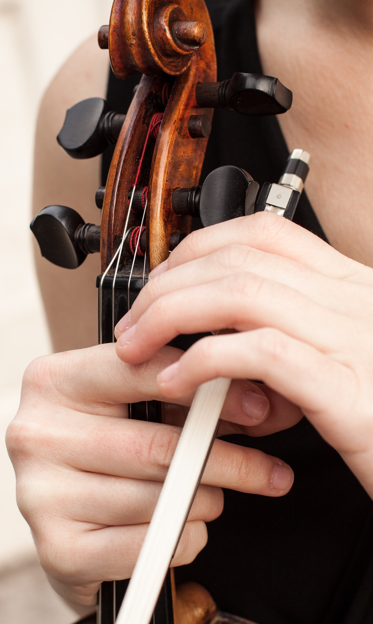
ADDITIONAL RESOURCES
Thank you for joining us for today’s video! You can access additional resources through the Fundraising Fundamentals series:
01
Review other topics via the Fundraising Fundamentals series.
Peruse the “CCS Insights” tab on our website.
Reach out to our team at info@ccsfundraising.com.
02
03

